Slide 1
String – subSequence method
Method | Description
CharSequence subSequence(int beginIndex, int endIndex) | Returns a new character sequence constructed from beginIndex index up until endIndex - 1.
subSequence(3, 6)
W | e | l | c | o | m | e
0
1
2
3
4
5
6
Starting Index
Ending Index

Slide 2
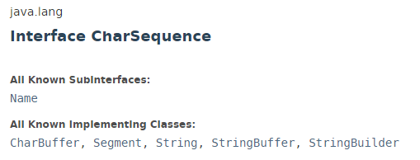
String – subSequence method

Slide 3
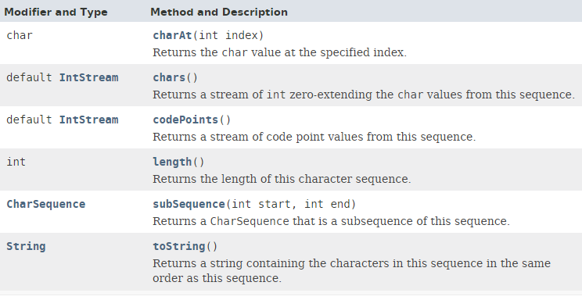
String – subSequence method

Slide 4
String – subSequence method
https://docs.oracle.com/javase/8/docs/api/index.html?java/lang/CharSequence.html

